Slide 1
Brent Crude Oil Prediction In Forecasting

Slide 2

Mentor Name : Ifthekar Team Members : Ms. Sindhu G Mr. Dhyeya Yogesh Trivedi Ms. Thalari Anitha Mr. Ankit Pandey Mr. Lalit Mohan Rawat

Slide 3
Objective
Crude oil is a naturally occurring, unrefined petroleum product composed of hydrocarbon deposits and other organic materials. A type of fossil fuel, crude oil can be refined to produce usable products such as gasoline, diesel and various forms of petrochemicals.
Oil is one of the most important commodities that its price and volatility has huge impact on everyone’s life on the planet. Impact of oil price and its applications on daily life is ´ undeniable, from all transportations, including fights, cars, and trains to daily consumer products such as tires, shampoo, paint and many more products. Oil is the major source of heating and energy in the world, which makes it challenge to replace it with other resources.
Oil heavily effect the economic growth, from common consumer products to military and energy sectors. Unexpected movements on oil price has effects on economic stability for both supplier and producer countries, although more crucial for oil importing countries.
Distillation, the process by which oil is heated and separated in different components, is the the first stage in refining.

Slide 4
EDA Exploratory Data Analysis (EDA) is an analysis approach that identifies general patterns in the data. These patterns include outliers and features of the data that might be unexpected. EDA is an important first step in any data analysis.

Slide 5
The Rise And Fall of Brent Oil
Brent oil is a type of crude oil extracted from the North Sea, and it is used as a benchmark for oil prices in Europe and other regions. Brent oil prices have fluctuated significantly in the past decade, influenced by various factors such as supply and demand, geopolitics, environmental issues, and market sentiment. In 2014, Brent oil prices reached a peak of over 100 euros per barrel, as the global economy recovered from the financial crisis and the demand for oil increased. As a result, Brent oil prices plummeted by more than 50% in 2014 and 2015, reaching a low of below 30 euros per barrel in early 2016. This caused severe losses for many oil companies and countries that rely on oil revenues, and also raised concerns about the environmental impact of burning fossil fuels. However, Brent oil prices rebounded in the following years, as the global demand for oil continued to grow, especially from emerging markets such as China and India. By 2020, Brent oil prices had recovered to around 70 euros per barrel, but the COVID-19 pandemic changed everything. The outbreak of the novel coronavirus and the subsequent lockdowns and travel restrictions imposed by many countries to contain the spread of the virus, caused a sharp drop in the global demand for oil, as people stayed at home and reduced their consumption of transportation and other oil-related products and services. At the same time, a price war erupted between Saudi Arabia and Russia, two of the largest oil producers, after they failed to agree on extending their production cuts in March 2020. This led to a flood of oil in the market, and a collapse of Brent oil prices, which briefly turned negative in April 2020, meaning that sellers had to pay buyers to take their oil. In 2021 and 2022, Brent oil prices continued to increase, as the global demand for oil outpaced the supply, and as OPEC+ maintained their discipline and gradually eased their production cuts. Moreover, some factors that supported the prices included the US rejoining the Paris climate agreement and imposing sanctions on some oil-producing countries, the cold weather in Europe and Asia that increased the demand for heating oil, the cyberattack on a major US pipeline that disrupted the supply of oil, and the ongoing conflicts and instability in some oil-rich regions.
By 2023, Brent oil prices had reached a high of over 80 euros per barrel, as the global economy recovered from the pandemic and the demand for oil soared.
Some analysts warned that the high oil prices were unsustainable and could trigger a backlash from consumers, governments, and investors, who might seek alternative and cheaper sources of energy, such as natural gas, renewables, and hydrogen.
In early 2024, Brent oil prices started to decline, as the supply of oil increased, and as the demand for oil slowed down. Some of the reasons for this trend included the rise of the US shale industry, which became more competitive and resilient, the expansion of the Iranian oil exports, after the US lifted its sanctions following a nuclear deal, the emergence of new variants of COVID-19, which threatened to derail the economic recovery and the oil demand, and the growing pressure from the public and the regulators, who demanded more action and accountability from the oil industry to reduce its carbon footprint and to address the climate change crisis. By February 2024, Brent oil prices had fallen to around 75 euros per barrel, and some experts predicted that they would continue to fluctuate in the range of 70 to 80 euros per barrel in the near future.

Slide 6
Visulisations And Analysis From EDA And Forecast Model
“
”

Slide 7
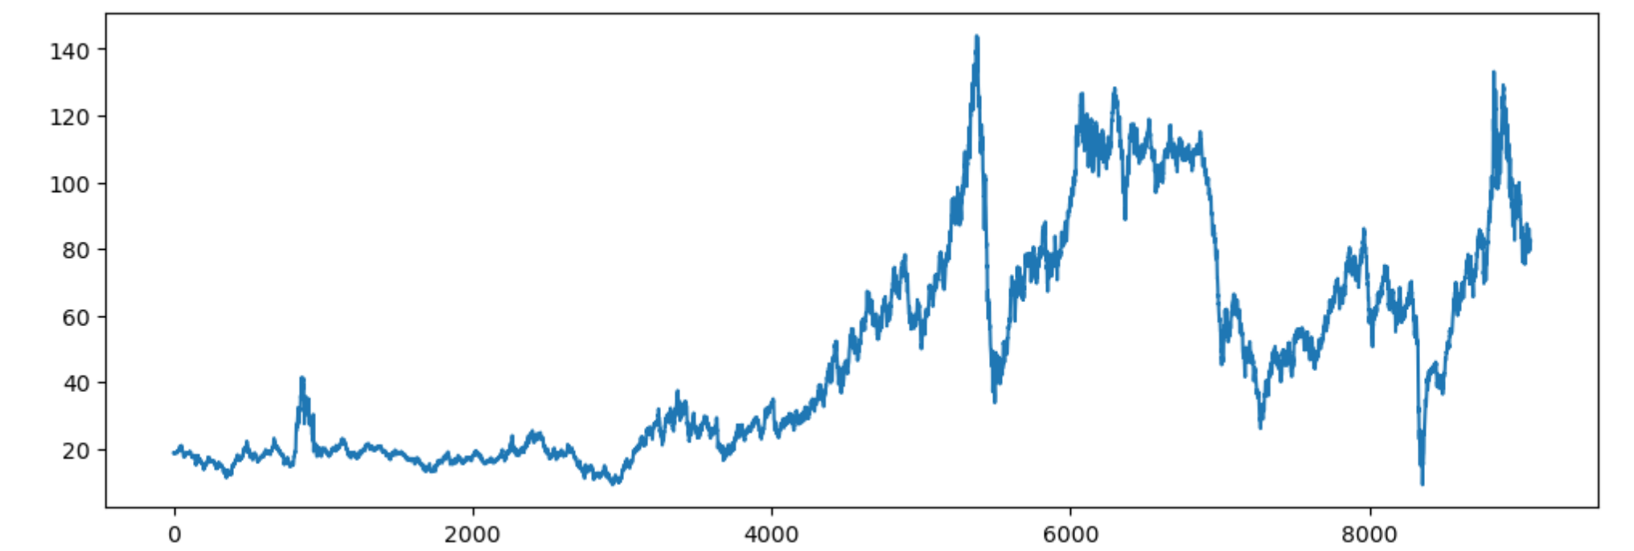
Visualization – Date v/s Price

Slide 8
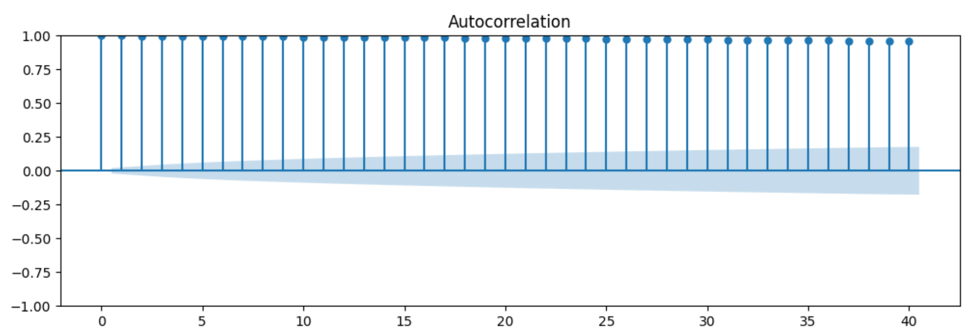
Autocorrelation And Partial Autocorrelation

Slide 9
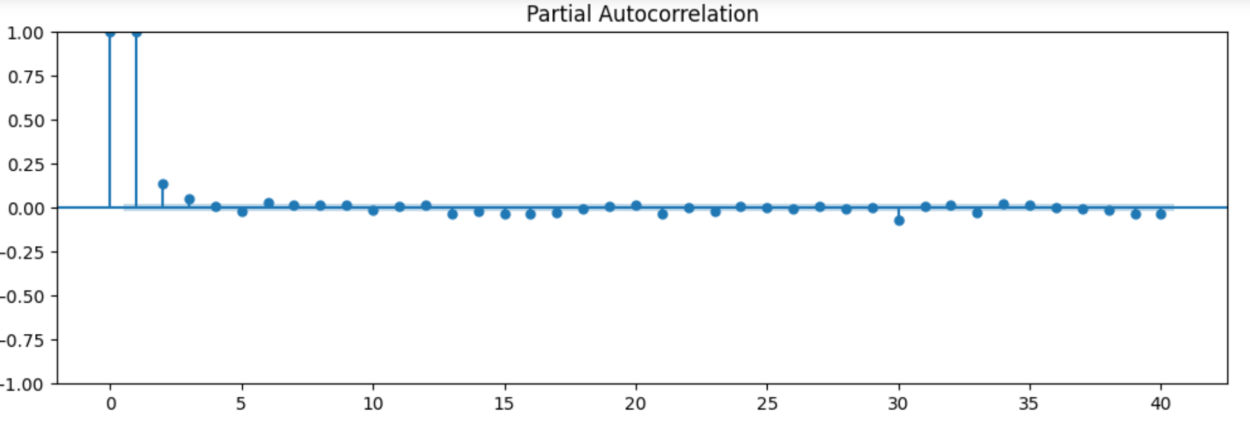
ACF graph shows the autocorrelation function (ACF) of a time series data, which measures how the values of the data are related to their past values at different time lags. The graph can help identify patterns or trends in the data, such as seasonality or cyclical behavior. Here are some key points to understand the graph The y-axis shows the correlation coefficient, which ranges from -1 to 1. A positive value means that the data values tend to move in the same direction, while a negative value means that they tend to move in opposite directions. A value close to zero means that there is no linear relationship between the data values and their past values. The x-axis shows the time lag, which is the number of time units between the current value and the past value. PACF graph shows the partial autocorrelation function (PACF) of the same time series data as the previous graph. The PACF measures how the values of the data are related to their past values at different time lags, after removing the effects of intermediate lags. The graph can help identify the appropriate order of autoregressive (AR) models for forecasting. Here are some key points to understand the graph. The y-axis shows the partial correlation coefficient, which ranges from -1 to 1. A positive value means that the data values tend to move in the same direction, while a negative value means that they tend to move in opposite directions. A value close to zero means that there is no linear relationship between the data values and their past values, after accounting for the effects of other lags. The x-axis shows the time lag, which is the same as the previous graph.

Slide 10
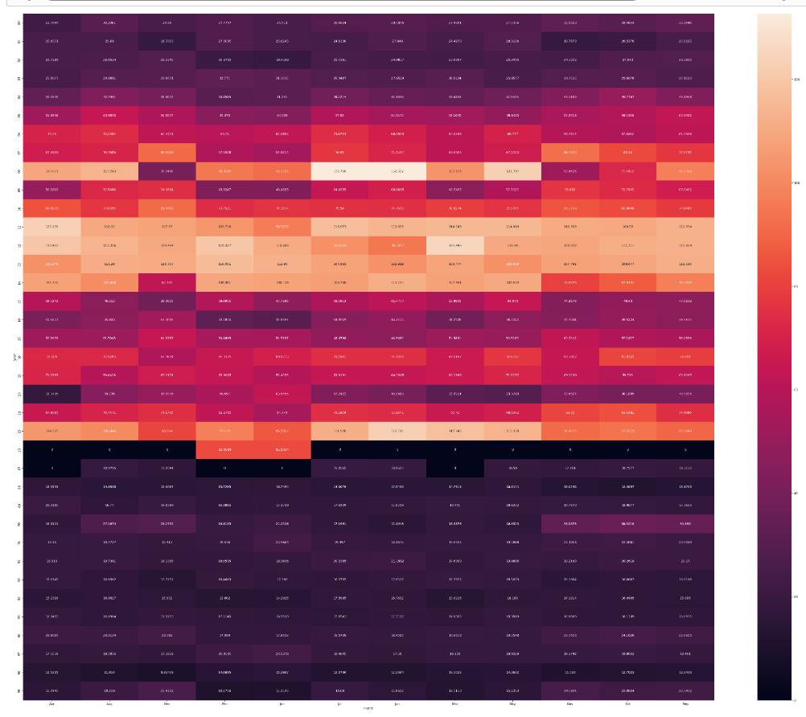
Seaborn Visualisation

Slide 11
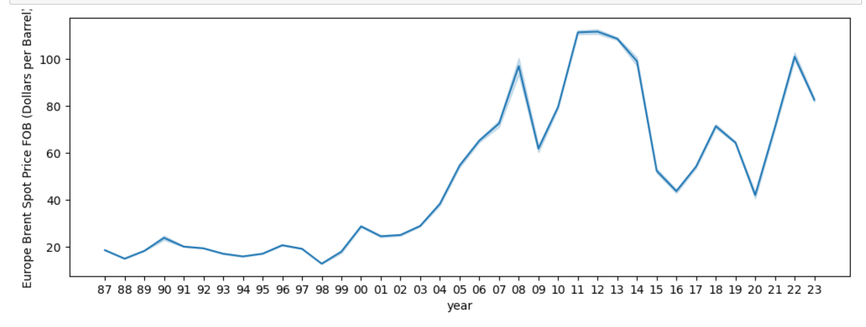
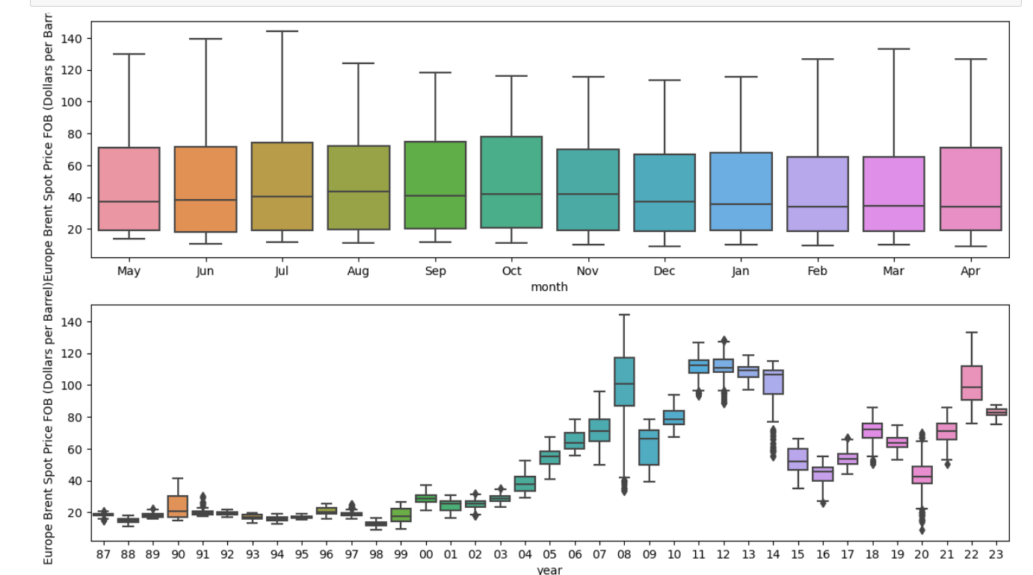

Slide 12
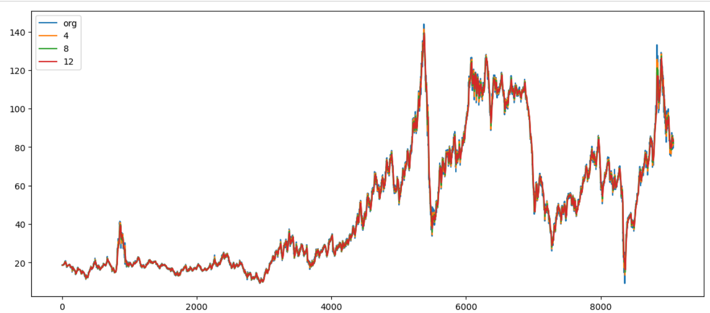
Moving Average Model

Slide 13
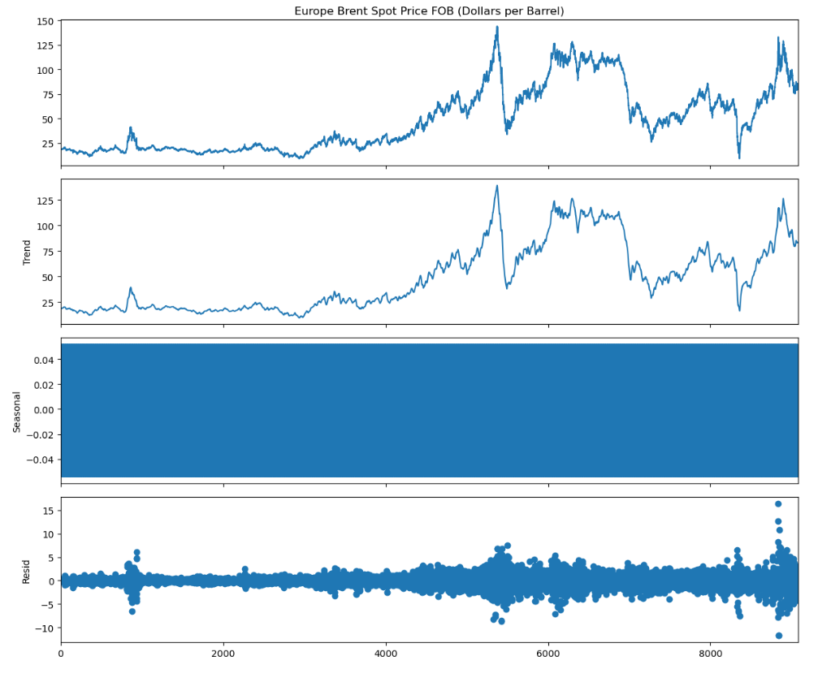
Chart To Understand Nature

Slide 14
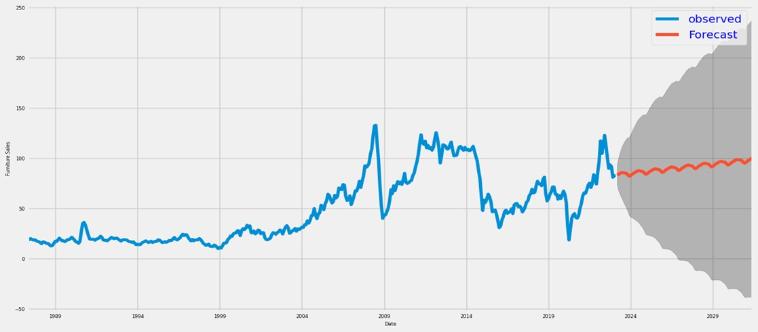
Forecasting Of Data Set

Slide 15
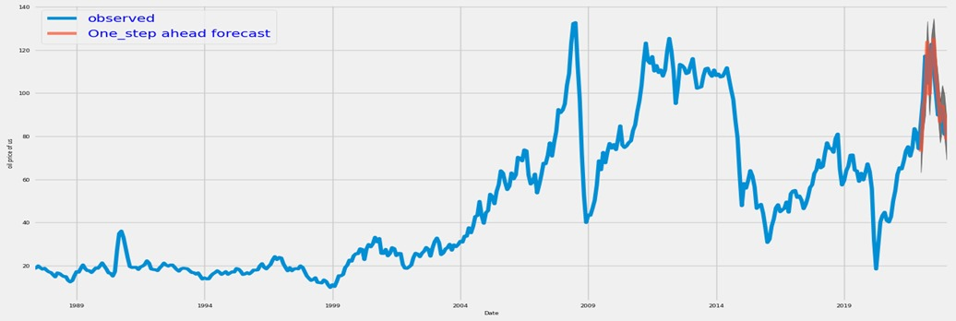
One Step Of Forecasting

Slide 16
Project Deployment
“
”

Slide 17
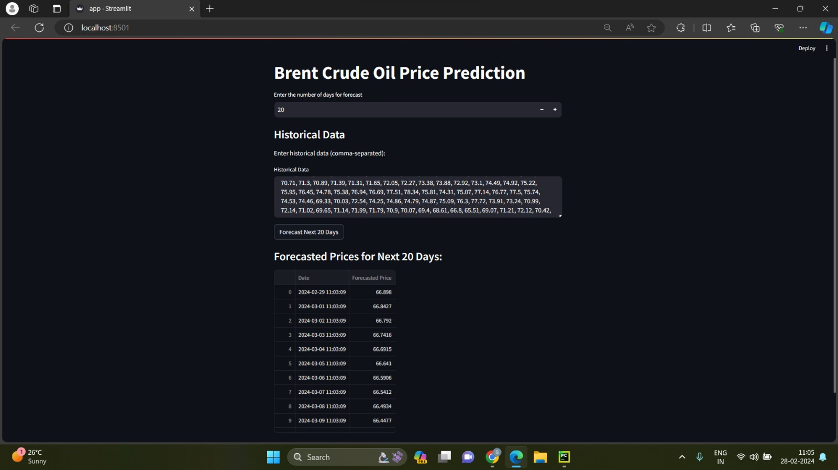

Slide 18
STREAMLIT
Streamlit is an open-source Python library that makes it easy to create custom web apps for machine learning and data science. In a world where data is king, Streamlit is the queen, providing the tools necessary to bring your data to life.
Streamlit's intuitive and user-friendly interface allows you to turn data scripts into shareable web apps quickly and easily. With just a few lines of code, you can create beautiful, interactive dashboards and data visualizations. Whether you're a seasoned data scientist or a beginner just dipping your toes into the data pool, Streamlit offers a versatile platform to help you understand and present your data.
Streamlit is not just for data visualization. It's also a powerful tool for machine learning. With Streamlit, you can quickly build interactive web apps to showcase your machine learning models. This can be particularly useful for demonstrating your model's capabilities to stakeholders or for debugging and model tuning.

Slide 19
LSTM MODEL
The LSTM model is a new type of deep machine learning neural network based on recurrent neural network (RNN) models. It focus on the process of deep learning and development. One of the key advantages of RNNs is that they can connect the previous information to the current task that is, the previous information can be memorized and applied for the calculation of the current output It has its own memory and can yield accurate predictions of crude oil prices. Besides that, LSTM models have excellent long-term and short-term memory ability, which will not lead to the loss of more historical state information on crude oil prices. It can fully extract historical information on the crude oil price and consider the characteristics of the current data for price information. LSTM models have great advantages in terms of mining the long-term dependence of crude oil price sequence data. Furthermore, LSTM models can automatically search for nonlinear features and complex patterns of crude oil prices, which shows excellent forecasting performance in crude oil price prediction. As a very powerful prediction tool, LSTM has been widely used in prediction-related fields. Therefore, in order to forecast crude oil price more accurately, we have selected the LSTM model for this study.t, and the time-series data can be analyzed and predicted.

Slide 20
Challenges Faced

Slide 21
Data Quality Assurance: Ensuring the quality and integrity of the data used for analysis and modeling, including handling missing values, outliers, and inconsistencies discovered during the EDA phase.
Feature Selection and Engineering: Identifying relevant features that contribute to accurate oil price forecasting and engineering them appropriately for model input, considering both domain knowledge and insights gained from EDA.
Model Selection and Tuning: Choosing the appropriate machine learning model, such as LSTM for time series forecasting, and tuning its hyperparameters to optimize performance while preventing overfitting.
Interpretability of LSTM Model: LSTM models, while powerful, can be challenging to interpret due to their complex architecture. Finding ways to interpret and communicate the model's predictions effectively to stakeholders.
Deployment Infrastructure: Setting up a robust infrastructure for deploying the LSTM model using Streamlit, ensuring scalability, reliability, and security while maintaining ease of use for end-users.

Slide 22
Methodology
Data Collection: Obtain historical oil price data from reliable sources such as financial websites, government agencies, or commercial data providers .Data Preprocessing: Prepare the data for LSTM model training by addressing missing values, outliers, and inconsistencies. Normalize the data to a scale between 0 and 1 for improved model convergence. Select relevant features, focusing primarily on historical oil prices. Sequence Generation: Organize the time series data into sequences suitable for LSTM model processing. Each sequence should comprise a fixed number of historical prices, for example, the prices of the past 30 days. This step enables the model to recognize temporal patterns in the data. Model Building: Construct the LSTM model using a deep learning framework like TensorFlow. Model Training: Train the LSTM model using the preprocessed data. The model learns to predict future oil prices by minimizing a loss function, such as Mean Squared Error, through optimization techniques like stochastic gradient descent. Model Evaluation: Assess the performance of the trained model using validation data that was not part of the training set. Common regression evaluation metrics include Mean Absolute Error (MAE), Mean Squared Error (MSE), and Root Mean Squared Error (RMSE).Prediction: Utilize the trained LSTM model to predict future oil prices based on unseen data. Input sequences of historical prices into the model to generate predictions for the upcoming time steps.

Slide 23
Applications
Understanding and forecasting fluctuations in oil prices plays a pivotal role across various sectors. For consumers, having foresight into oil price changes empowers them to adapt their spending habits, optimize transportation choices, and manage household budgets more effectively. In financial markets, accurate predictions of oil prices are indispensable for investors, traders, and financial institutions navigating commodity markets, enabling them to make informed decisions and mitigate risks. The transportation industry heavily relies on oil-derived fuels like gasoline and diesel, making oil price projections crucial for strategic planning and operational efficiency. Moreover, in the renewable energy sector, anticipating oil price movements aids in assessing the economic feasibility of renewable energy initiatives vis-à-vis traditional fossil fuels, shaping investment decisions and driving innovation towards sustainable energy solutions.

Slide 24
Conclusion
Oil prices represent a complex interplay of various influences, spanning geopolitical tensions, supply-demand dynamics, economic indicators, technological advancements, climatic shifts, and regulatory shifts. Different methodologies for modeling, such as time series analysis, econometric modeling, machine learning algorithms, and hybrid approaches, offer distinct advantages and considerations. The selection of an appropriate model hinges upon factors like data characteristics, forecasting horizon, interpretability needs, and available computational resources. Assessing the efficacy of prediction models necessitates robust metrics that encompass accuracy, reliability, and risk-adjusted returns. Key evaluation measures include Mean Absolute Error (MAE), Mean Squared Error (MSE), Root Mean Squared Error (RMSE), directional accuracy, and financial performance indicators.

Slide 25
Thank you
GROUP - 5

